Slide 1
Kinematics and Dynamics of Machines
MEL3020
Dr. Roshan Kumar Hota
Assistant Professor
rkhota@iitj.ac.in
Phone: 9775667313
Room 308
Mechanical Engineering Department
IIT Jodhpur

Slide 2
Velocity Analysis using instant centers

Slide 3
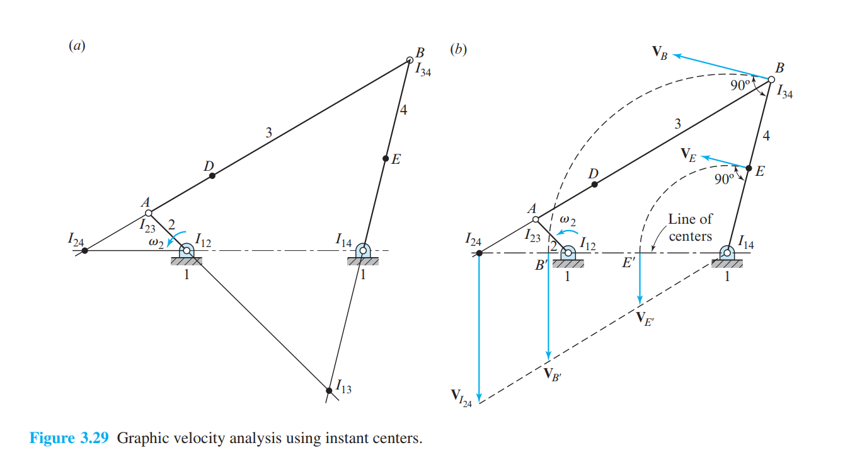

Slide 4
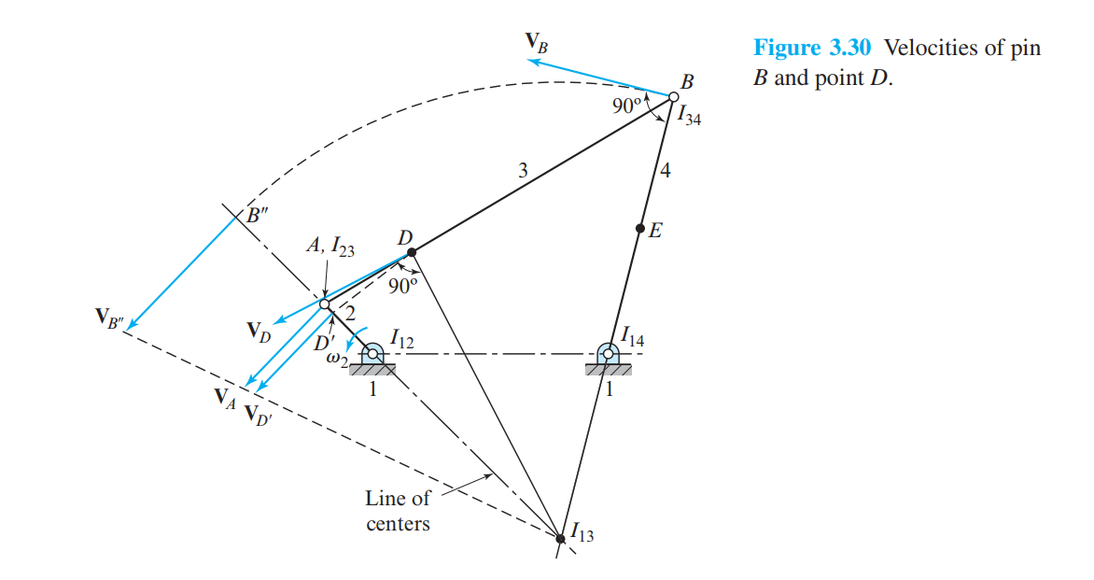

Slide 5
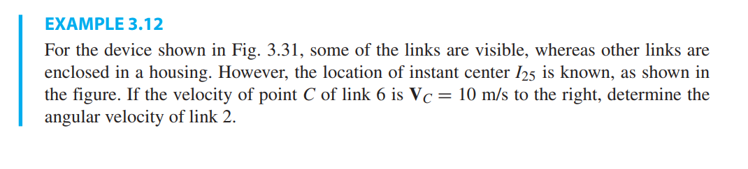
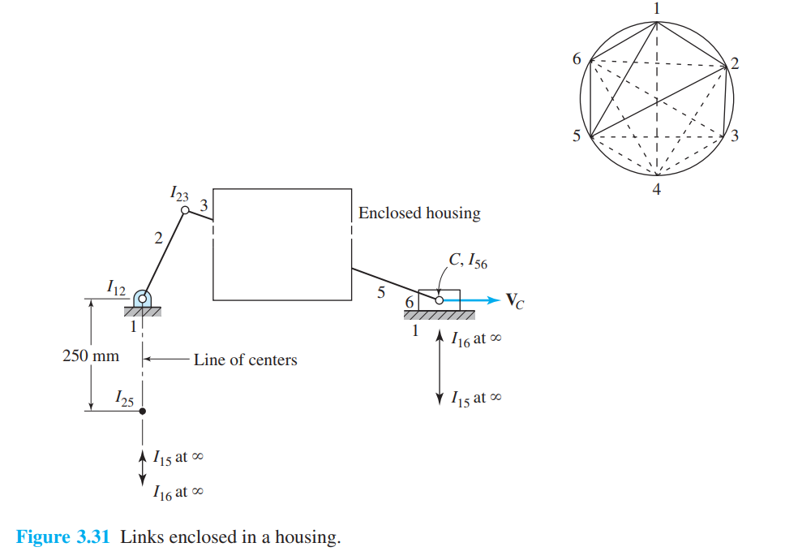

Slide 6
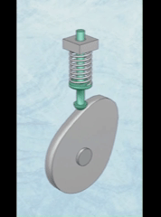
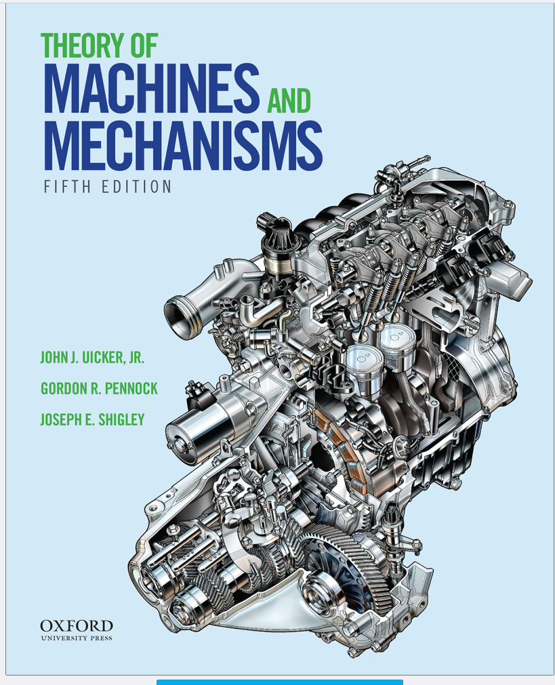
CAM Analysis

Slide 7
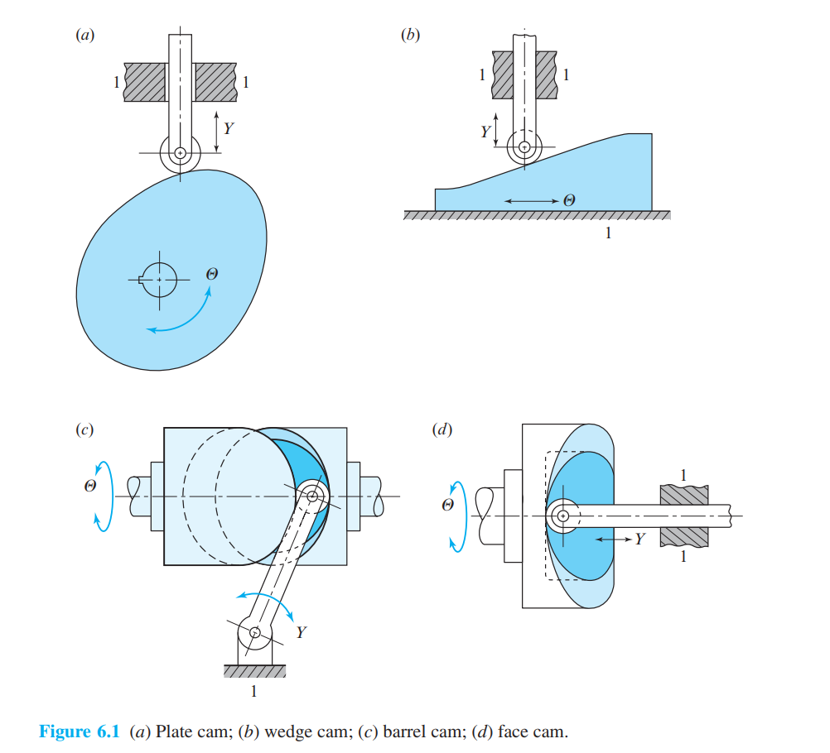
CAM Classification

Slide 8
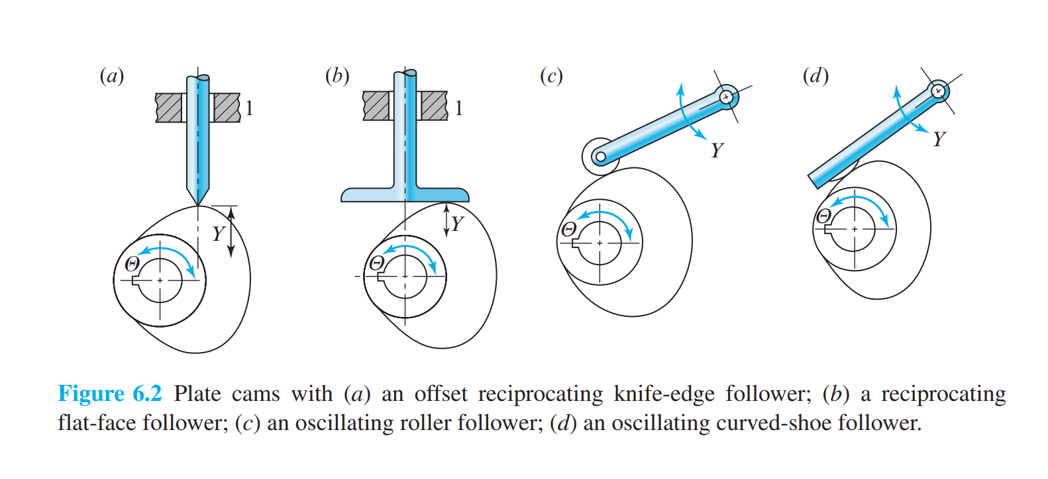
CAM Classification

Slide 9
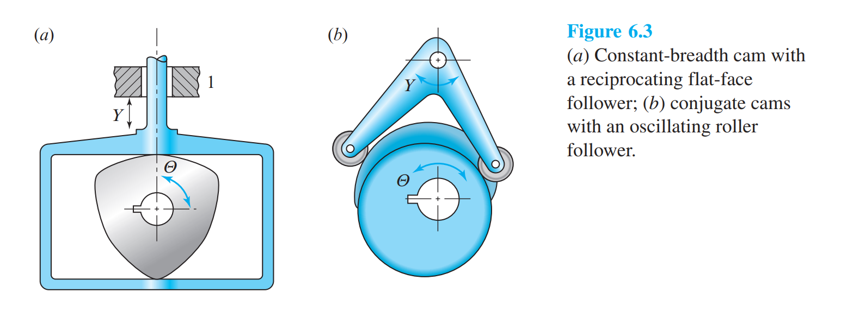
CAM Classification

Slide 10
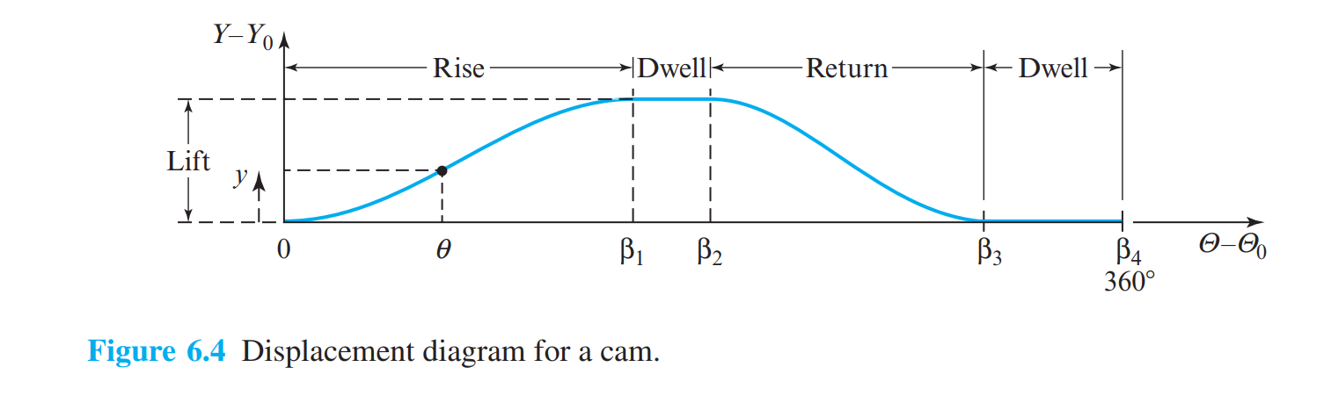
Displacement Diagrams

Slide 11
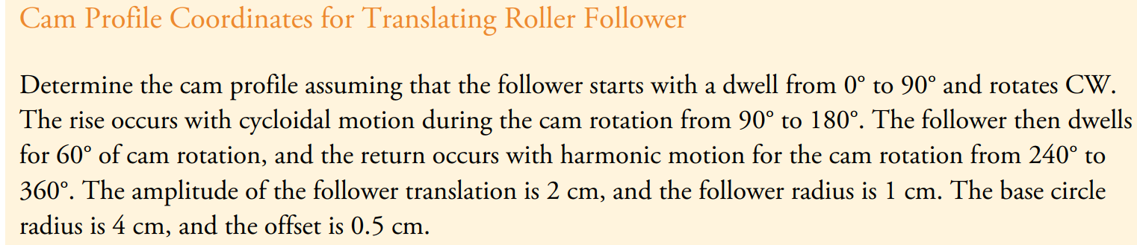
Example

Slide 12
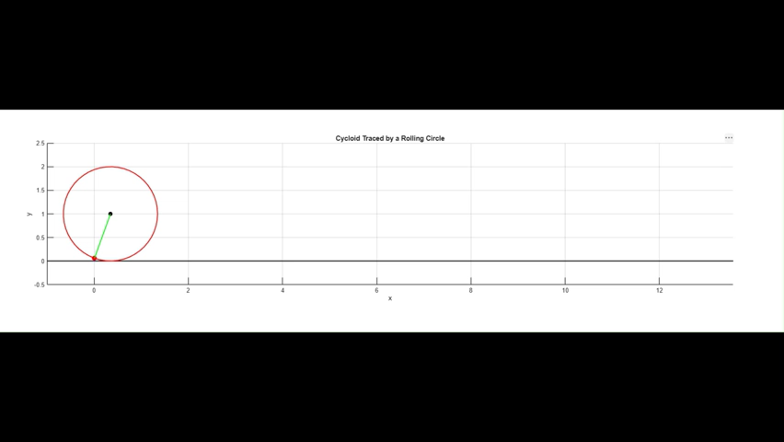
Example

Slide 13
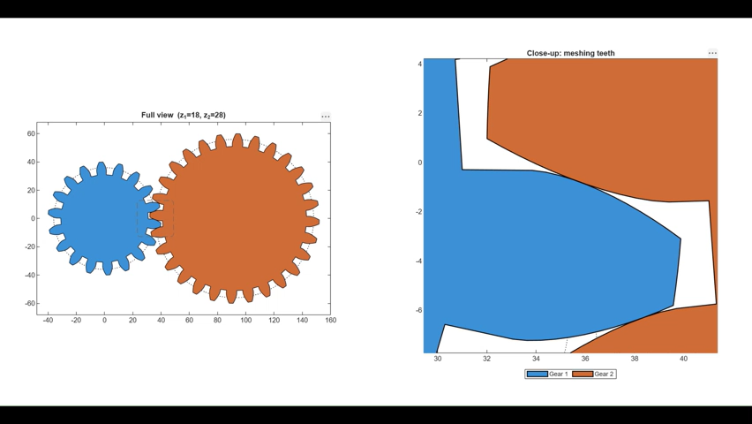
Meshing gear animation with involute profiles

